Slide 1
Associated Student Body Workshop
Hesperia Unified School District
August 9, 2013
Presented by:
Michelle Plumbtree
Chief Management Analyst, FCMAT

Slide 2
The ASB Accounting Manual and Desk Reference
A revised manual was released December 2012
Can be accessed and downloaded for free from
  FCMAT’s website at www.fcmat.org
  This revision includes updated useful information as well as increases the number of forms and templates available in Microsoft Word and Excel on the FCMAT website.

Slide 3
ASB Types
Unorganized
  Elementary and K-8 school sites
  Also: Adult Ed, Special Education, ROP, Continuation
  Usually no student council or student clubs
  Limited student decision making: School Principal/Trustee oversees raising and spending of funds and CAN make all decisions.
    Note: Although the Principal/Trustee can make the decisions, this does not change the rules on how and why we raise and spend these ASB funds.
  Requirements are not as strict

Slide 4
ASB Types, cont.
Organized
  Middle and high schools
  Activities are organized around student clubs and a student council
  Students are the primary authority when making decisions for the ASB:
    Formal meetings
    Develop budgets
    Plan fund-raisers
    Decide how funds will be spent
    Approve payments
  Advisors and school principal
    Provide assistance, advice, and co-approve

Slide 5
Starting up ASB and/or New Clubs
Submit a formal application that includes:
  Title, powers and duties of the officers and the manner of their election
  Scope of proposed activities
  Name of organization
  Endorsed by a certificated club advisor
New clubs must be approved by:
  Student council
  Principal
All new clubs should be formed according to the ASB constitution and board requirements in your specific district.

Slide 6
Starting up ASB and/or New Clubs, cont.
All clubs need to be approved, even activity clubs for liability reasons
  Needs a certificated club advisor
  If no financial activity, then there is no need for monthly meetings with minutes or budgets

Slide 7
Are we ready, and truly understand, what an Organized ASB is?

Slide 8
Organized Student Body
Middle schools and high schools
  Activities are organized around
    Student Clubs
    Student Council

Slide 9
Student Club and Trust Accounts
What is a CLUB then?
    Composed of currently enrolled students at that specific school site
    Certificated employee as an advisor
    Students MUST play a major role
    Students are the primary authority when making decisions
    Have approved constitution
    Elected officers
    Must have a budget
    Formal meetings
    Minutes of meetings
    Clubs report to the student council

Slide 10
Student Club and Trust Accounts, cont.
Funds held in trust by student council
  ASB constitution or bylaws should state what happens to funds of inactive clubs
  If constitution or bylaws silent, would revert to general ASB account
    i.e. Student Council or Leadership Class
  Try to spend money for same reason is was raised for
  Define what an inactive club is
    i.e. 18 months (district can determine)

Slide 11
Don’t Forget!
  The district is ultimately responsible for ASB funds and expenditures.
  Anyone involved with ASB has a responsibility to report suspected fraud or abuse to principal and/or the business office.

Slide 12
How Do Parent Groups Fit In?
Parent group funds cannot be commingled with district/ASB funds
  Non-student groups cannot deposit funds into the
  ASB accounts unless they are truly being donated
  to the ASB
  Once the funds are donated to ASB, only the student organizations control how the funds will be used
  The Manual gives detailed information about non-student groups in Chapter 21

Slide 13
District Board Policy and Regulations
Govern:
  Establishment of the student body organization
  Supervision of the organization’s activities
  Operation and management of the organization’s finances
  It is important ASB’s are aware of district policy because district policy applies to the ASB.
  District Board Policy is another law that ASB must follow

Slide 14
Business Office:
Receives and reviews bank statements MONTHLY
Reviews budgets and financial reports MONTHLY
Internal audits and oversight
Resource to site staff
Develops and updates the ASB manual, policies and procedures
Training and help resolve audit findings
Ensures that the ASB is correctly reporting sales and use taxes

Slide 15
Site Principal:
Works with district office
Approves fund raising events
Approves expenditures along with students and ASB advisor
Appoints the ASB and Club advisors
Supervises ASB bookkeeper and ASB advisors
Enforces and communicates all laws, policies and procedures
Ensures that a Student Council is created and established and approves Club constitutions
Ensures minutes are kept of all ASB and club meetings
Receives and reviews bank statements MONTHLY
Reviews budgets and financial reports MONTHLY

Slide 16
ASB Advisor(s):
Must be a CERTIFICATED employee
Needed for EACH Club & Student Council/Leadership Class
Works directly with students on a day-to-day basis, supervising the activities and serving as a link between the students to the ASB bookkeeper and the principal
Makes absolutely SURE that ONLY pre-approved, valid purchases are made and AUTHORIZED by the STUDENTS from Student Funds

Slide 17
ASB Advisor(s):, cont.:
Assists the students in preparing the annual budget and revenue projection estimates
Makes absolutely SURE that proper INTERNAL CONTROLS are in place and functioning for fund-raising activities
Ensures that the clubs are having meetings and keeping minutes
Reviews with the students all budgets and financial reports and transactions

Slide 18
ASB Bookkeeper:
Normally, site ASB bookkeeper safeguards money held at school site –
  Vigilant in safeguarding funds in order to get those funds to ASB bank account in a timely manner.
  WEEKLY DEPOSITS or more (2 to 3 days best) – No Deposit Holding – Late deposits risk stale checks, etc.
  Prepare proper financial records of financial transactions in accordance with established procedures and policies
    i.e., Club reports, check registers, deposit registers, etc.
  Bank reconciliation “EVERY” month.

Slide 19
ASB Bookkeeper:, cont.
Normally, Site ASB bookkeeper safeguards money held at school site –
  Maintaining the change box, receipt books, tickets, etc.
  Processing purchase orders, payments, and invoices.
  UPHOLDS ASB LAWS – POLICIES - PROCEDURES, AKA, “THE GATE KEEPER”

Slide 20
Student Council:
If unorganized, Student Council is not mandatory
Develop and approve annual budget for Student Council and Leadership Class
Authorize ALL:
  Student Club budgets
  Student Clubs
Reviews ALL:
  Student Club fund-raising events
  Student fund purchases/expenditures

Slide 21
Student Council:, cont.
Review ALL Student Clubs:
  Financial reports
  Reconciliations
  Anything else they would like to review
Student Council:
  Represents the students
  Primary authority of how student-raised funds will be spent

Slide 22
That's A LOT of Work!
I thought it was easier to spend money from ASB, not harder!

Slide 23
Healthy ASB
Oversight
Budgets
Revenue Potentials
Internal Controls
Notes:
Keeping things straight is the only way to go.

Slide 24
Budgets
Budget is an ESTIMATE
  Each year you will get better at it
  If the budget is going off-track during the year, REVISE it
Budget = Usually One Year
  Often Forgotten; AT END OF SCHOOL YEAR, prepare NEXT YEAR’S Budget. (Needed to conduct business)
  This Next Year Budget can be as simple as using current year actual revenue and expenditures
Have a requirement that a budget needs to be in place and approved BEFORE the Club enters into any commitments or requests that contracts be entered into --- or DO NOT let them spend.

Slide 25
Budgets, cont.
Budget CARRYOVER
  Possible; HOWEVER – Students should spend what they raise
  Seed money for next year = OK
  Reasonable carryover balances = OK
  Multi-Year projects w/carryover balances = OK
  Get permission to do carryover and/or set percentage limits
  Yes, there is a form to get approval to carry over funds from the prior year

Slide 26
What Happens When a Class Graduates?
Funds held in ASB can only be spent on CURRENT students
If graduating:
  Spend remaining funds prior to graduation
  Gift funds to another ASB club at the same school site
  Gift the funds to the general ASB at the same school site
    General ASB unless board policy or constitution says otherwise
Balances cannot “follow” students if graduating from 8th grade and going to high school
  Stay at same school where funds are raised
If class has already graduated, need to clear funds
  General ASB unless board policy or constitution says otherwise

Slide 27
What Should We Know About Raising Money?
Obtain proper district governing board approval.
  ASB fund-raising events should be approved at the beginning of year, by the board or whoever the board delegates to do so, or the governing board should approve policies and administrative regulations that delineate allowable and unallowable fund-raising events.
Ensure parent organizations coordinate the timing of their fund-raisers with ASB fund-raisers so they aren’t in competition with each other.

Slide 28
What Should We Know About Raising Money?, cont.
Always use pre-numbered receipt books or tickets and reconcile, reconcile, reconcile.
Always count funds with a witness and counter sign the proper deposit forms.
Make the bank deposit THAT DAY if possible!
Don’t take Funds Home.
If you cannot deposit the money that day - PUT THE MONEY IN THE SAFE WITH A WITNESS PRESENT!!

Slide 29
Revenue Potential
The Revenue Potential form is an internal control requirement and a finding occurring in independent audits when they are not in existence
Can also be called a “Fund-raising Event Profit Form”, “Revenue Potential” or “Revenue Projection, but they all mean the same thing and are required regardless of what it’s called!

Slide 30
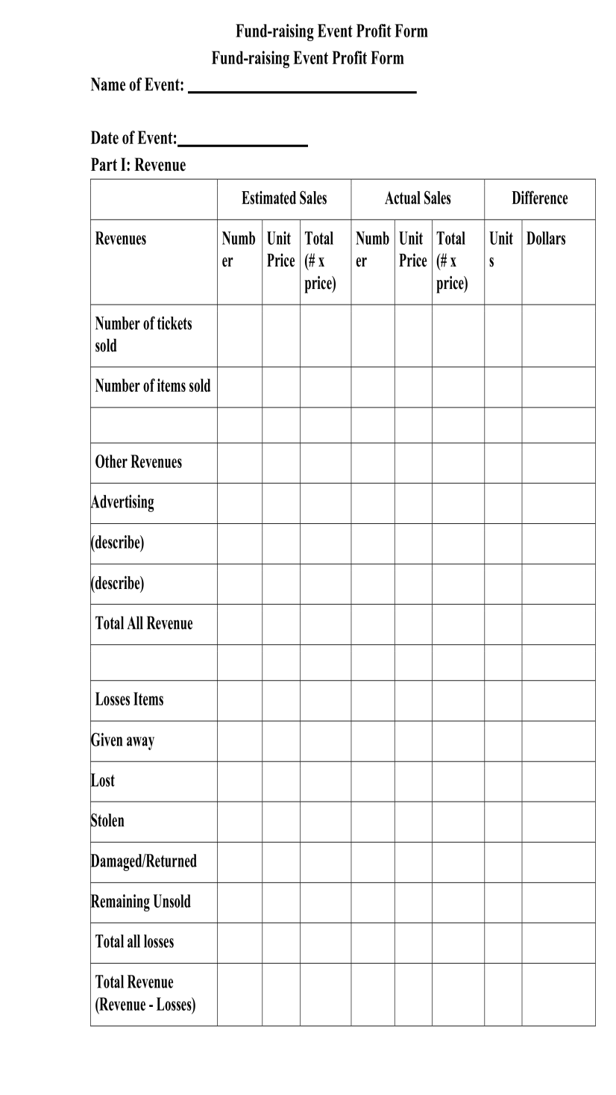
Revenue Potential, cont.

Slide 31
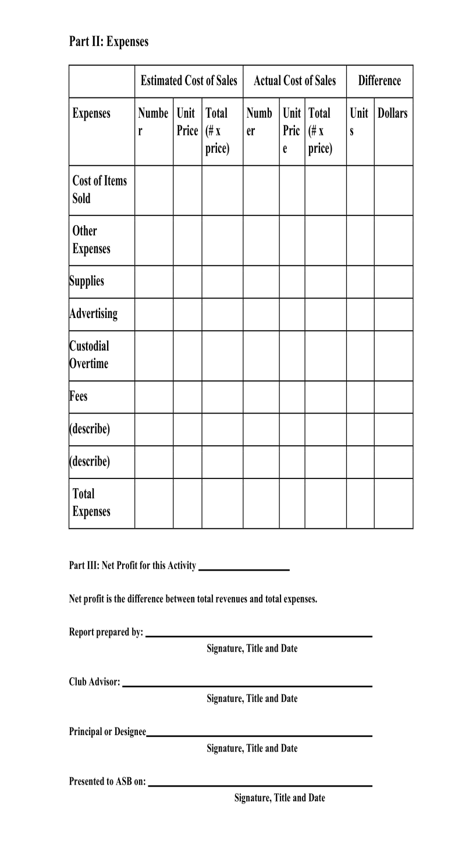
Revenue Potential, cont.

Slide 32
Revenue Potential, cont.
It is an ESTIMATE with your ACTUAL results and the difference all shown in the same form.
  The students will learn:
    Projecting for an expectation
    Why actual results are different or why actual results agree
  Yes, there may be some guessing for the estimate section
  ESTIMATE SECTION MUST BE FILLED OUT PRIOR TO EVENT
  Revenue potential form can be the document that is compiled and submitted to the board or designee for approval of the event.
  Can serve as the document to ensure that the site administrator is informed and approves of all fund-raising activity at the site.
  The form is also a way to notify the bookkeeper to anticipate a deposit.

Slide 33
Unallowable Fund-raisers
By law:
  Raffles, Bingo, and other games of chance
  Who can do a raffle:
    Private non-profit groups (Not ASB)
    Non-profit must have a California Business License for at least one year
    Own tax ID number
    Must register annually with Attorney General’s Registry of Charitable Trusts prior to raffle and receive confirmation of the annual registration prior to holding the raffle
    Must distribute at least 90% of proceeds to beneficial or charitable purposes
  Department of Justice www.caag.state.ca.us

Slide 34
Unallowable Fund-raisers, cont.
Due to lack of insurance coverage (pose liability, safety or risk concerns):
  Mechanical or animal rides
  Use of darts, arrows, or other weapons
  Objects thrown at people (i.e., pie toss)
  Dunk tanks
  Destruction of objects (i.e., using a hammer)
  Trampolines
Ownership Issues:
  Rental of district property (equipment or facilities to outside groups)
Fees not authorized by the Education Code:
  See the FCMAT ASB Manual, for more information on what fees are not allowable.
  There are new complaint laws in place, deadline March 2013, per AB 1575
    All public schools are required to publish local policies and procedures to implement provisions of AB 1575
    Information is to be included in the annual parental
    notification

Slide 35
Unallowable Fund-raisers, cont.
  An ASB fundraiser must be preapproved and consist of students raising money in order to purchase “extras” for their educational experience.
  It is not legal for teachers to raise funds to increase their site budgets by fundraising using the district’s tax ID number. If they do, the funds are considered taxable income to the teacher.
  There’s a big difference when students fundraise using the district’s tax ID number compared to teachers fundraising using the district's tax ID number. One is legal; the other is not!

Slide 36
Donations
Yes, ASB can gladly accept donations of money or property if the donation is for appropriate ASB expenditures.
But they can’t be:
  Required
  Mandatory
  A prerequisite to participate in a program or activity
All ASB rules and guidelines apply to any received donations.
Make sure you know if the district’s board policy on donations has special provisions/instructions for how ASB donations are to be acknowledged or accepted.

Slide 37
ASB Accounts are Not Pass-Through Accounts
ASB accounts should not be used as pass-through or clearing accounts.
Only money that should be deposited into ASB:
  Actual ASB funds
  Will be used for appropriate ASB purposes

Slide 38
Cash Control Procedures
Most fraud that occurs in ASB directly related to procedures for handling of cash and checks.
Internal controls CRITICAL
  Protect ASB’s assets (cash)
  Protect students, employees and staff who handle cash from accusations or errors.
Principal must ensure:
  Proper cash control procedures established and followed:
    During fund-raising event.
    When cash and checks given to ASB bookkeeper for deposit into ASB account.
  Ensure that unless cash control procedures in place for the fund-raiser, the event cannot be held.

Slide 39
Cash Control Procedures, cont.
Must be able to tie all proceeds to the specific fund-raiser from which they were generated.
Ensure all proceeds from an event are properly turned in and accounted for.
Proper internal controls include:
  Proper inventory of concession items
  Proper cash handling and physical chain of custody for all cash receipts
  No commingling of receipts from separate events
  Immediate delivery of all event proceeds to the ASB bookkeeper
  Use of three-part receipts when turning in all event proceeds

Slide 40
Cash Control Procedures, cont.
  Dual cash counts
  Endorse all checks – “For Deposit Only …”
  Safe storage
  Timely deposits (2-3 days)
    Never leave un-deposited money at a school over weekends or holidays
  Control over tickets and receipt forms
  Report overages and shortages
    Loss of tickets the same as loss of cash

Slide 41
Cash Control Procedures, cont.
Cash Control Procedures include:
  Pre-numbered tickets for all sales events
  Cash register for store-type sales
  Pre-numbered receipt books for receipt transactions
  Tally sheets for designated activities
  Inventory control for vending machines, stores, and
  concession stands
  Cash boxes to keep the received money safe

Slide 42
Cash Control Procedures for ASB Bookkeepers
Provide materials to ASB advisors for fund-raisers, and keep stock on hand
  Ticket rolls
  Receipt books
  Forms
Responsible for receipts once received from ASB advisor until deposited.
  Count cash in presence of another person
Principal must work with each student organization to develop methods for securing cash collected after hours and on non-school days.

Slide 43
Deposits
VERY HIGH FRAUD INDICATER when deposits are not timely
  When deposits are late:
    Checks can become stale and difficult to cash
    Donor must re-Issue check and perception of “lack of caring or negligence” by the ASB
    Heavy Audit Findings – District governing board takes notice
  Deposit at least WEEKLY for ANY amount (every 2-3 days best)
  Deposit DAILY if SIGNIFICANT amount
  DO NOT LEAVE MONEY IN YOUR DESK, CABINET, OR ANYWHERE OTHER THAN THE SITE SAFE AND/OR DISTRICT OFFICE.
  Count all cash with a WITNESS and sign off on the deposit count as cash goes through the chain of custody process.

Slide 44
Bank Reconciliation Internal Controls should include:
Timely reconciliations
  Within two weeks of receiving bank statement
Principal/ASB Advisor review
  Make sure outstanding items are cleared within one month.
  Initial and date the bank reconciliation and bank statement as evidence they equal.
Present reconciled reports to student groups
  Monthly
  Report should be entered into the minutes
Business office review monthly and signed off as reviewed.

Slide 45
Allowable Expenses
Must be in compliance with the law and local board policy
Must promote the students’ general welfare, morale, and educational experience
Must be directly linked to the students’ benefit
Must be pre-approved
Must be outside of what the school district should provide, or has provided in past, from their own general funding sources
Must benefit a group of students (with few exceptions)

Slide 46
Allowable Expenses, cont.
Expenses CANNOT be considered a gift of public funds
  Must have a direct or substantial purpose
  Misappropriation of public funds is considered a criminal act, with no monetary limit specified
  Better to be safe than sorry

Slide 47
Allowable Expenses, cont.
Gift of Public Funds
Article 16, section 6
  Expenditures of school funds must be for a direct and primary public purpose to avoid being a gift of public funds
    Private individuals are benefitted only incidentally to the promotion of the public purpose
  Approved public purpose must be within the scope of a school district’s jurisdiction and purpose
Expenditures that most directly and tangibly benefit students’ education are more likely justified
  Expenditures driven by personal motive are not justified even if they have a long-standing custom or are based on benevolent feelings

Slide 48
Allowable Expenses, cont.
Gift of Public Funds
To justify the expenditure of public funds, the governing board must determine that the expenditure will benefit the education of students within its schools
If the governing board has determined that a particular type of expenditure serves a public purpose, courts will almost always defer to that finding
  Put in board policy
Can be considered a gift of public funds unless in board policy
  Flowers
  Scholarships
  Donations to charity

Slide 49
Allowable Expenses, cont.
Examples:
  Student magazines and newspaper subscriptions
  Supplemental equipment for student use not provided by
  the school (i.e., telescopes)
  Field trips/excursions/outdoor education camps
  Extra-curricular athletics costs
  Social events for students
  Awards are allowable only if there is a district policy allowing awards
  Substitute teacher if the teacher is absent due to an authorized ASB event

Slide 50
Unallowable Expenses
Ask these questions:
  Does the expense directly promote the general welfare, morale or educational experience of the students?
  Does the expense benefit students as a group?
  Are you sure the expense can’t be considered a gift of public funds?
If you answer NO to the questions above, the expense is probably unallowable.
NO = Don’t spend from ASB funds!!!!!

Slide 51
Unallowable Expenses, cont.
Include:
Regular curriculum and classroom supplies
Salaries/supplies that are the district’s responsibility
Repair and maintenance of district equipment/facilities
Items for employee personal use
Faculty meeting costs
Parent group costs
Large awards unless approved in board policy
Gifts of any kind
Employee appreciation meals
Employee clothing/attire
Donations

Slide 52
Are Awards Allowed?
Board required to adopt rules and regulations about awards
  if no policy or regulations, no awards allowed
Authorized by E.C. 44015
Awards are allowed to employees for exceptional contributions and to students for excellence.
Only student awards should come from ASB
Awards cannot exceed $200 in value unless board policy states a higher amount.
Awards are not authorized to community members, parents, or volunteers.
Awards are not allowed for birthdays, weddings, funerals or holidays.

Slide 53
Are Awards Allowed?, cont.
Awards to employees for exceptional contributions are allowed if the employee:
  Proposed procedures or ideas that are adopted and resulted in eliminating or reducing district expenditures or improving operations.
  Performed special acts or special services in the public interest.
  Made exceptional contributions to the efficiency, economy or other improvement in operations of the district.
  And should be paid from district funds

Slide 54
Are Awards Allowed?, cont.
FCMAT’s recommendation: Awards are only allowed if there is an approved board policy in place and if award does not violate other district policies (i.e. wellness policy) . Only allow student awards from ASB funds.

Slide 55
Are Gifts Allowable?
If it is not an award, it is a gift, and gifts are unallowable.
Gifts are NOT allowable, even if small in amount.
  People have tried to say that if a gifts value is “de minimis”, trivial or of little value, it would be okay (for example, under $20/person).
    Court cases say differently -- a gift is a gift
  Gift certificates are ordinarily characterized as gifts of public funds even when purchased for an event with a public purpose because they confer a tangible private benefit to an individual.
    Ask merchants or individuals to donate gift certificates to avoid making a gift of public funds
  If students want to give gifts, use private funds, not public funds.

Slide 56
Are Gifts Allowable?, cont.
FCMAT’s recommendation: Gifts are NEVER allowed.

Slide 57
Are Donations to Other Organizations Allowed?
Donations are considered a “Gift of Public Funds”
  Funds have been raised under the district’s non-taxable status.
Students can still organize fund-raisers to support specific charities if clearly identified as such
  If so, the checks should be written to the organization/charity.
  An exception can exist only if district governing board approves a special fund-raising event with the funds clearly segregated within the ASB account.
Note: Donations are not allowed for needy families. A legal foundation must be established separate from the district.

Slide 58
Are Donations to Other Organizations Allowed?, cont.
FCMAT’s recommendation: Donations to other organizations are not allowed from ASB funds unless specific governing board approval has been authorized.

Slide 59
Are Scholarships Allowed?
Yes, if the following exists:
  Governing board, or authorized designee, approves the scholarship donation.
  Acceptance must be in writing, including all conditions prescribed by the donor.
  Statement must also be included regarding the disposition of any remaining balance.
  Each scholarship and trust account must be established separately.
  The donation cannot be for a specific student(s).
Students may organize fund-raisers to raise money for scholarships
  If the district governing board approves a special fund-raising event with the funds clearly segregated within the ASB account.

Slide 60
Are Scholarships Allowed?, cont.
If scholarships are going to be allowed from ASB funds, the following must occur:
  There must be an unbiased committee who selects the recipients.
  The selection criteria must be determined prior to beginning the fund-raising or acceptance of any donations.
Scholarship check(s) must be made payable directly to the college.

Slide 61
Are Scholarships Allowed?, cont.
FCMAT’s recommendation: Scholarships are not allowed from ASB funds unless the previous criteria have been approved and established in advance.

Slide 62
Is Employee Clothing/Attire Allowed?
Not Allowed.
  No specific statutory or case authorizes such expenses
    It is not allowed because it directly benefits an individual
  Employee clothing and attire expenditures may be considered a gift of public funds.

Slide 63
Is Employee Clothing/Attire Allowed?, cont.
FCMAT’s recommendation: Students shouldn’t be raising money to outfit employees.

Slide 64
Are Employee Appreciation Meals Allowed?
Not Allowed
Appreciation meals do not qualify as awards.
Attorney General says not “actual and necessary” per E.C. 44032.
Don’t provide a direct and/or substantial purpose -- so would be a gift of public funds.

Slide 65
Are Employee Appreciation Meals Allowed?, cont.
FCMAT’s recommendation: Employee appreciation meals are not allowed.

Slide 66
Contracts for ASB
Contract - legally binding document
  Whoever is authorized to sign contracts under district policy are the same individuals that are allowed to sign ASB contracts.
    School principals and ASB advisors are not usually board- approved signers. Make sure you check your district board policy before signing any contract.
  Follow district policy regarding contracts
    Authorized signers
    Dollar limits
    Required review/authorization
  District contract policies and procedures protect the ASB, the students, and their assets.

Slide 67
What Happens When the ASB Pays for a District Employee’s Services?
Sometimes a district employee does extra work for the ASB that the ASB will pay for.
If this happens:
  The extra work is paid through district payroll and the ASB then reimburses the district.
ASB must pre-approve the expense before the work occurs.
The extra work will be reported on the employee’s annual W-2 issued by the district.

Slide 68
What’s a Consultant?
Not an employee
Independent from the district
  Disk jockey
  Photographer
Is not paid as an employee in ANY other capacity
  If the proposed consultant is already a district employee, they cannot be paid as a consultant for this work.
ASB must pre-approve the expense before the work occurs
Paid directly by ASB with a vendor check
Fills out W-9 prior to working
Income reported on IRS form 1099 annually

Slide 69
What Happens When a District Employee does Consultant Work for ASB?
The consultant-type work is paid through district payroll and the ASB then reimburses the district.
ASB must pre-approve the expense before the work occurs.
The extra work will be reported on the employee’s annual W-2 issued by the district.
This is because the same person can’t be paid as an employee and a consultant by the same employer.

Slide 70
Internal Controls/Spending
Spending student money MUST be accomplished with sound internal controls, great accounting practices & conform to your board of education regulations (E.C. Sec.48933).
  All disbursements MUST be:
    Budgeted
    Properly authorized by students
    Paid ONLY from ORIGINAL documents/receipts, etc.
    Service/product/goods MUST be RECEIVED and authorized

Slide 71
Internal Controls/Spending, cont.
  Purchase orders must be completed PRIOR to the purchase.
    Organized ASB’s
      Pre-approved by three (3) signatures on PO
          Student representative
          Certificated club advisor
          Board designee (normally the principal)
    Un-organized ASB’s
      Pre-approved by only one signature on the PO
          This signor/trustee is normally the principal

Slide 72
Internal Controls/Spending, cont.
  All disbursements MUST be:
    Reflected in club minutes:
      Issuance of the PO
      Approval of the PO
      Payee information, i.e., the check number, amount, and name.
    Be audit ready with an audit trail
    Records are retained as established by policy or procedure

Slide 73
Are Purchase Orders Really Necessary?
YES! Must be issued for purchases to reflect proper approval.
ASB not obligated to pay for an expenditure ordered or directly purchased by a teacher, student or other person who has not first received a purchase order with the appropriate approval signatures.
  You cannot just go shopping on your own and expect to be reimbursed.
P.O.’s must be pre-numbered and have multiple copies.

Slide 74
Internal Controls
  Policies and procedures that:
    Ensure that accounting and business operations are effective and efficient
    Safeguard and preserve the organization’s assets
    Promote successful fund-raising ventures
    Protect against improper fund disbursements
    Ensure that unauthorized obligations cannot be incurred
    Provide reliable financial information
    Reduce the risk for fraud and abuse
    Protect employees and volunteers
    Ensure compliance with applicable laws and regulations

Slide 75
Internal Controls, cont.
Segregation of duties according to their functions so that one person does not handle a transaction from beginning to end.
  Those who initiate, authorize or approve transactions
  Those who execute the transactions
  Those who record the transactions
  Those who reconcile the transactions
  Those responsible for the item resulting from the transactions

Slide 76
Internal Controls, cont.
Purchase order/requisition completed prior to purchase or ASB is not obligated to pay for the expenditure.
Never pay expenses from cash receipts
  Deposit cash and then write a check
Keep the checkbook and extra check stock in a safe, secure place.
Void checks that are incorrect or not issued.
Never sign checks in advance -- have a backup signer.
Use checks in proper sequence
Never make check out to cash
Check needs two (2) signatures

Slide 77
Journal Entries and Transfers
Control is required
  Purpose must be documented with a detailed reason
  Needs supporting documentation
Should be prepared only with prior written approval
  ASB advisor
  Principal
  Club meeting minutes

Slide 78
ASB Minutes Requirements
The student council and each club must prepare and maintain a record of each meeting and action taken in them
  Details of proceedings
  Actions taken
  Demonstrate that policies and procedures are followed by ASB
Need to be concisely and clearly written

Slide 79
ASB Minutes Requirements, cont.
Any information introduced to those attending the meeting should be attached to the original copy and kept on file, such as listing of purchase orders, listing of checks, financial information and letters
The club secretary, or whoever took the minutes, should sign the minutes when they are completed
Review and approve at next meeting
Maintain a binder of all of the approved minutes for the school year

Slide 80
Auditors
Good resource
  Annual Financial Review
  Report findings
  Help fix procedures
  Protect the district by offering a third party line of defense for why ASB policies and procedures are necessary
  Auditors report directly to the governing board

Slide 81
Why Are There So Many Issues, Including Audit Findings, in ASB?
Cash transactions
Decentralized with many players
Accounting by non-accountants
Inadequate
  Internal controls
  Communication
  Training and guidance
  Standardization
  Oversight

Slide 82
Audit Findings
  Significant and Common Audit Findings:
    Expenditure or purchase PRIOR to purchase order approval or PO not used at all.
    Actual purchase date is prior to the purchase order date
    The three (3) signatures for organized or one (1) signature for unorganized ASB’s required by EC are not obtained prior to purchase.
    A lack of confirmation that the product purchased was received prior to payment.
    Lack of proper documentation, i.e. no revenue projections.

Slide 83
Audit Findings, cont.
    Cash receipts not traceable.
    The who, what, when, where and why’s are missing on the documentation.
    Receipt books are not used and/or properly completed.
    Cash collection form and ticket numbers are not used and/or reconciled.
    Deposits received are not taken to the bank in a timely manner.
    Bank reconciliations not prepared monthly.

Slide 84
Audit Findings, cont.
Auditors review a sampling of transactions
  They may not find everything that they should.
Incorrect procedures undetected by auditors should still be corrected – Remember, this protects you, the students, and the ASB.

Slide 85
When you Have Questions
District Office
FCMAT’s on-line help desk. You can visit the help desk at www.fcmat.org and review the previously asked questions and answers and will most likely find your question. If you have a situation that has not been previously addressed, you will be able to submit your question through the website.

Slide 86
Any Questions???

Slide 87
Thank You For Attending

